Slide 1
Managing Fixed Assets
RTR AA Managing Fixed Assets - DRAFTC

Slide 2

Prerequisites and Ground Rules
Ground Rules
  Single conversation
  Please “Raise Hand” in Teams
Prerequisites
  SAP Overview & Navigation
Roles
  Employee
  Asset Accountant
  Accounts Payable Accountant
  General Ledger Accountant
Duration of Class
  5 hrs
Class Attendance
  Attendance log

Slide 3
Welcome!
Classroom Logistics
  Computer and User IDs
  Course schedule: duration and breaks
  Facilities and breakroom
  Attendance Sheet
  Parking Lot
Safety concerns (as needed)
Hand out copies of all written materials (as appropriate)

Slide 4
Welcome to Virtual Training!
Classroom Logistics
  Computer and User IDs
  Course schedule: duration
  Attendance Tracking
  Parking Lot
Check: Participants have copies of all materials
Link to electronic versions of Work Instructions, Job Aids, and SIMs at SuccessFactors

Slide 5

Course Objectives
You should be able to:
Describe the fixed assets process
Create Asset Master Data
Process different types of transfers
Perform the various methods for depreciating assets
Generate fixed assets reports

Slide 6
Agenda
Unit 1 – Introduction – Fixed Assets (20 mins)
Unit 2 – Creating/Editing Assets (60 mins)
Unit 3 – Processing Asset Transfers (60 mins)
Unit 4 – Depreciating an Asset (110 mins)
Unit 5 – Generating Fixed Assets Reports (60 mins)
Unit 6 – Summary (10 mins)

Slide 7
1
You should be able to:
Describe the fixed assets process
Define new SAP terms for fixed assets

Slide 8
What Are Fixed Assets?
A Fixed Asset is a long-term tangible or intangible piece of property that FAI owns and/or leases and is not expected to be consumed or converted into cash in the near future
Examples of fixed assets for FAI include:
  Computers
  Office Furniture
  Software
  Leasehold Improvements
The value of the asset is recorded on the organization’s balance sheet

Slide 9
Sub-Processes: Process Flow
Procuring Assets (Needed)
Registering Assets (Needed)
Transferring Assets (Optional)
Adjusting Assets (Optional)
Depreciating Assets (Needed)
Disposing Assets (Optional)
The Fixed Assets Life Cycle:
  Starts with an asset being procured
  The asset is registered (added) in the system
  Any adjustments during the life of the asset made as required
  Transfers when needed are performed in the system
  Managing the depreciation of an asset as necessary using various methods
  Removal of a fixed asset (disposal) when it is obsolete or no longer in use

Slide 10

What’s In It For Me?
The Bad:
Potential process changes to accommodate navigation in a new environment
Needing to invest time to learn a new system
The Good:
A comprehensive Fixed Assets module which allows for the financial lifecycle of an asset to be captured and maintained from acquisition to retirement
Helps to ensure the asset acquisition lifecycle is managed in a centralized location with on time results and minimal manual intervention
  For FAI:
Provides an integrated solution that includes other modules such as: Purchasing, Sales, and Projects
I’ll just trike-out

Slide 11
New Terms
New Term | Definition
Fixed Asset | Fixed assets are long-term assets property, equipment, or intellectual property a company owns and used in its operations to generate income. Fixed assets are also referred to as tangible assets having a physical form or intangible having no physical form such as software.
Capitalization | Process of recording an acquisition and production cost as a fixed asset instead of as an expense
Depreciation Area | A dimension showing the valuation of an asset according to a particular accounting standard
Depreciation Type | Reason for the depreciation
Retirement | Removal of an asset or part of an asset from the asset portfolio

Slide 12

Unit 1, # 1
What is a benefit of SAP?

Slide 13
Unit 1, # 1
What is a benefit of SAP?
  Helps to ensure the asset acquisition lifecycle is managed in a centralized location with on time results and minimal manual intervention

Slide 14

Summary – Unit
You should now be able to:
Describe the fixed assets process
Define new SAP terms for fixed assets

Slide 16
Agenda
Unit 1 – Introduction – Fixed Assets (20 mins)
Unit 2 – Creating/Editing Assets (60 mins)
Unit 3 – Processing Asset Transfers (60 mins)
Unit 4 – Depreciating an Asset (110 mins)
Unit 5 – Generating Fixed Assets Reports (60 mins)
Unit 6 – Summary (10 mins)

Slide 17
2
You should be able to:
Explain the create asset master data process
Create an asset number
Change an asset number
Describe how to display calculations of an asset

Slide 18
Creating an Asset Number
An asset number, in combination with the company code, uniquely identifies an asset in the system
Asset numbers allows the organization to report on a balance sheet and ensure assets are bought or created to increase the value or benefit the organization's operations
Utilize SAP t-code AS01 to create an asset number
Procuring Assets (Needed)
Registering Assets (Needed)
Transferring Assets (Optional)
Adjusting Assets (Optional)
Depreciating Assets (Needed)
Disposing Assets (Optional)

Slide 19
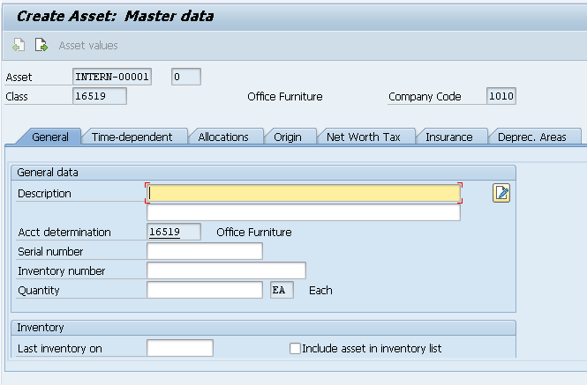
Create an Asset Number – SAP t-code: AS01
Important tabs that require entry include:
  General
  Time-dependent
  Origin
You cannot move to the next tab without first completing the required fields of the tab you are currently on

Slide 20

Demo 2.1: Create an Asset Number
A new asset is available for FAI and requires an asset number
Notes
  Transaction Code: AS01
Notes:
Demonstration using:
Field: value
Field: value
Action
Other steps

Slide 21

Exercise 2.1: Create an Asset Number
A new asset is available for FAI and requires an asset number
Create Asset Number
Notes
  Transaction Code: AS01
Notes:
Data Fields:
Field: value
Field: value

Slide 22
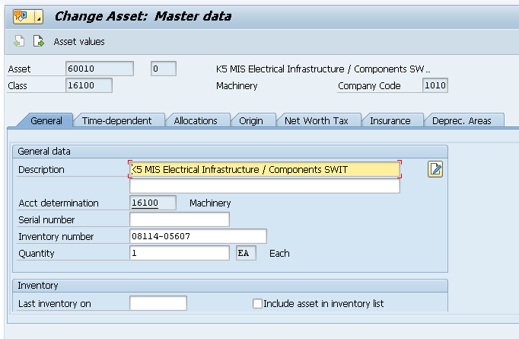
Change an Asset Number – SAP t-code: AS02
Use SAP t-code: AS02 to make changes to an asset number record
Items that can be updated include:
  Description
  Inventory number
  Quantity

Slide 23
Demo 2.2: Change an Asset Number
An existing asset number requires a change to the Description, Business Area, and Cost Center
Notes
  Transaction Code: AS02
Notes:
Demonstration using:
Field: value
Field: value
Action
Other steps

Slide 24
Exercise 2.2: Change an Asset Number
An existing asset number requires a change to the Description, Business Area, and Cost Center
Create Asset Number
Notes
  Transaction Code: AS02
  Business Area and Cost Center fields are located on the Time-Dependent tab
Notes:
Data Fields:
Field: value
Field: value

Slide 25
Creating an Asset Master Record
Some things to consider when creating an asset:
Maintaining fixed assets involves creating, changing, and displaying asset master records
Key features of Asset Master Data are:
  Master data does not change frequently
  Fixed number of key attributes can be used to capture the relevant details of the asset for analysis and reporting
The data provided for the master record is based on the purchase information
Procuring Assets (Needed)
Registering Assets (Needed)
Transferring Assets (Optional)
Adjusting Assets (Optional)
Depreciating Assets (Needed)
Disposing Assets (Optional)

Slide 26
Asset Master Data Attributes
Basic information is established when creating the asset master data record:
  An asset number to identify the asset
  Department responsible for the asset
  Cost account for the asset
  Date the asset was required
  Description that allows you to locate the asset
  Location
  Asset end user
  To create a master record enter:
  General data of the asset
  Asset depreciation group
  Property tax or Transport tax

Slide 27
Demo 2.3: Create Asset Master Data Record
The FAI organization has purchased computer equipment for the Dallas location. An asset master record must be created
Notes
  Transaction Code: AB01
  An asset number must exist in the system prior to creating a purchase requisition for the asset
  Prior to the purchase of an asset, the PR requestor sends the accounting team a request for asset number via email which contains all information required
  Once approved the asset master record is created and the asset number is sent to the PR requestor
Notes:
Demonstration using:
Field: value
Field: value
Action
Other steps

Slide 28
Exercise 2.3: Create Asset Master Data Record
The FAI organization has purchased computer equipment for the Dallas location. An asset master record must be created
Create Asset Master Data Record
Notes
  Transaction Code: AB01
Notes:
Data Fields:
Field: value
Field: value

Slide 29
Adjusting an Asset - Revaluation
Revaluation of fixed assets is the process of increasing or decreasing their carrying value in case of major changes in fair market value of the fixed asset
Perform the following to process asset revaluation/impairment:
  Execute Asset revaluation
  Run Depreciation (month End)
* The posting is not reflected in G/L until the depreciation has been run for the period.
Procuring Assets (Needed)
Registering Assets (Needed)
Transferring Assets (Optional)
Adjusting Assets (Optional)
Depreciating Assets (Needed)
Disposing Assets (Optional)

Slide 30
Revaluation/Impairments Process Flow
Revaluation
BU
Request Asset Revaluation
NO
FA
Accountant
Execute Asset Revaluation?
Run Depreciation
Asset Explorer
AW01N
View Impaired Asset Values
Looks Good?
YES
YES
End
NO
Notes:
This chart is incorrect and should be removed. (csa)

Slide 31
Asset Write Up
A write-up is a change to the valuation of an asset (reversal of depreciation)
Write-ups increase the book value of a fixed asset and can only be created for depreciation in prior years
Typical reasons to perform a write up include:
  Forgot to capitalize an asset in a fiscal year that is now closed (usually called post-capitalization).
  The value adjustments that were calculated in the past were too high and must now be corrected using a write-up in the current fiscal year

Slide 32
Demo 2.4: Perform an Asset Revaluation
The fair market value of a laptop has increased and a revaluation must be processed to increase the carrying value
Notes
  Transaction Code: ABAW/AR29N
Notes:
FAI has never used the write up functionality as it relates to FMV. We have adjusted the acquisition cost if an input error was made
Demonstration using:
Field: value
Field: value
Action
Other steps

Slide 33
Exercise 2.4: Perform an Asset Revaluation
The fair market value of a laptop has increased and a revaluation must be processed to increase the carrying value
Generate an asset revaluation
Notes
  Transaction Code: ABAW/AR29N
Notes:
FAI has never used the write up functionality as it relates to FMV. We have adjusted the acquisition cost if an input error was made
Data Fields:
Field: value
Field: value

Slide 34
Unit 2, # 1
What is one of the main components needed in order to create asset master data in the system?

Slide 35
Unit 2, # 1
What is one of the main components needed in order to create asset master data in the system?
  You must enter general data of the asset in order to create the master data record in the system

Slide 36
2
You should now be able to:
Explain the create asset master data process
Create an asset number
Change an asset number
Describe how to display calculations of an asset

Slide 37

Time for a Break!
Class starts again in 10 minutes

Slide 39
Agenda
Unit 1 – Introduction – Fixed Assets (20 mins)
Unit 2 – Creating/Editing Assets (60 mins)
Unit 3 – Processing Asset Transfers (60 mins)
Unit 4 – Depreciating an Asset (110 mins)
Unit 5 – Generating Fixed Assets Reports (60 mins)
Unit 6 – Summary (10 mins)

Slide 40
3
You should be able to:
Perform the steps needed to process an intracompany transfer
Initiate the process for a transfer within a company code from one asset to another
Complete the steps needed to process a transfer between affiliated companies

Slide 41
Intracompany Transfers
Reasons for processing an intracompany transfer (transferring one fixed asset to another within the same company code):
  Changes made to an org structure (reclassification)
  Account assignments are incorrect (e.g. incorrect asset class)
  Asset is ready for a summary settlement
Intracompany transfers can be carried out in one step using transaction code: ABT1N
Procuring Assets (Needed)
Registering Assets (Needed)
Transferring Assets (Optional)
Adjusting Assets (Optional)
Depreciating Assets (Needed)
Disposing Assets (Optional)

Slide 42
Intracompany Transfer – ABT1N
Some things to consider when performing an intracompany transfer:
A master record for the target asset must exist prior to processing the transfer
If a current-year acquisition must be transferred, first perform a reverse posting, followed by a (correct) acquisition posting
Intracompany transfers are only possible if no values from the sending asset are lost and every area of the target asset is supplied with values

Slide 43
Demo 3.5: Process an Intracompany Transfer
An asset settlement must now be processed
Notes
  Transaction Code: ABT1N
  An asset master record must exist prior to processing a transfer
  Training for mass changes for upload via template
Notes:
Performing a group via template upload, that can be done.
Demonstration using:
Field: value
Field: value
Action
Other steps

Slide 44
Exercise 3.5: Process an Intracompany Transfer
An asset settlement must now be processed
Process an intracompany transfer
Notes
  Transaction Code: ABT1N
  An asset master record must exist prior to processing a transfer
Notes:
Data Fields:
Field: value
Field: value

Slide 45
Transfers Between Companies
Moving fixed assets from one corporate group company to another (intercompany)
An intercompany transfer represents a retirement for one company and an acquisition for the other
An intercompany asset transfer may be necessary for one of the following reasons:
  The physical location of the asset has changed, making it necessary to assign the asset to a new company code
  The organizational structure of the corporate group has changed, requiring the asset assignment to a different company code
Procuring Assets (Needed)
Registering Assets (Needed)
Transferring Assets (Optional)
Adjusting Assets (Optional)
Depreciating Assets (Needed)
Disposing Assets (Optional)

Slide 46
Demo 3.6: Process an Intercompany Transfer
A fixed asset must be reassigned from one cost center to another
Notes
  Transaction Code: ABUMN
Notes:
Demonstration using:
Field: value
Field: value
Action
Other steps

Slide 47
Exercise 3.6: Process an Intercompany Transfer
A fixed asset must be reassigned from one cost center to another
Process a transfer within the same company code
Notes
  Transaction Code: ABUMN
Notes:
Data Fields:
Field: value
Field: value

Slide 48
Transfers Within Affiliated Companies
Initiated when a parent company needs to make an asset transfer to a subsidiary company
May be necessary for one of the following reasons:
  The physical location of the asset has changed
  The organizational structure of the corporate group has changed
Procuring Assets (Needed)
Registering Assets (Needed)
Transferring Assets (Optional)
Adjusting Assets (Optional)
Depreciating Assets (Needed)
Disposing Assets (Optional)
Notes:
Remove slide

Slide 49
Demo 3.7: Process a Transfer Within Affiliated Companies
A fixed asset is being transferred from Fujitsu Japan to the Dallas location
Notes
  Transaction Code: ABZP
  A sales transaction is typically required to start the process
Notes:
Remove
Demonstration using:
Field: value
Field: value
Action
Other steps

Slide 50
Exercise 3.7: Process a Transfer Within Affiliated Companies
A fixed asset is being transferred from Fujitsu Japan to the Dallas location
Process a transfer from the parent to the subsidiary location
Notes
  Transaction Code: ABZP
  A sales transaction is typically required to start the process
Notes:
Same comment as previous slide
Data Fields:
Field: value
Field: value

Slide 51
Unit 3, # 1
What important item is needed in order to process an intracompany transfer?

Slide 52
Unit 3, # 1
What important item is needed in order to process an intracompany transfer?
  An existing master record must be available prior to processing the transfer

Slide 53
3
You should now be able to:
Perform the steps needed to process an intracompany transfer
Initiate the process for a transfer within a company code from on asset to another
Complete the steps needed to process a transfer between affiliated companies

Slide 54
Time for a Break!
Class starts again in 60 minutes

Slide 56
Agenda
Unit 1 – Introduction – Fixed Assets (20 mins)
Unit 2 – Creating/Editing Assets (60 mins)
Unit 3 – Processing Asset Transfers (60 mins)
Unit 4 – Depreciating an Asset (110 mins)
Unit 5 – Generating Fixed Assets Reports (60 mins)
Unit 6 – Summary (10 mins)

Slide 57
4
You should be able to:
Complete an asset sale without a customer
Scrap an asset
Perform a manual depreciation when required
Process a monthly depreciation calculation
Perform an asset retirement using the scrap process

Slide 58
Asset Sale Without Customer – ABAON
Reasons for processing an asset sale without a customer transaction include:
  The book value of the asset is lower than the revenue (sales price)
  Value is bigger than the revenue (sales price)
  Equal to the revenue (sales price): no additional account has to be posted.
Procuring Assets (Needed)
Registering Assets (Needed)
Transferring Assets (Optional)
Adjusting Assets (Optional)
Depreciating Assets (Needed)
Disposing Assets (Optional)

Slide 59
Asset Sale Without a Customer Process Flow
Asset Retirement with Revenue but no Customer Involvement
BU
Review Asset List for assets to be disposed
Send the List of assets to be disposed
FA
Accountant
Approve?
Asset Sale Without Customer
ABAON
NO
YES
End
Notes:
Remove

Slide 60
Demo 4.8: Process an Asset Sale Without a Customer
A laptop is being retired with revenue that must be recorded
Notes
  Transaction Code: ABAON
Notes:
Demonstration using:
Field: value
Field: value
Action
Other steps

Slide 61
Exercise 4.8: Process an Asset Sale Without a Customer
A laptop is being retired with revenue that must be recorded
Process an asset sale without a customer
Notes
  Transaction Code: ABAON
Notes:
Data Fields:
Field: value
Field: value

Slide 62
Scrapping an Asset
Result of an unexpected permanent reduction in the value of an asset
After completion, it is posted to all of the depreciation areas specified and is displayed separately
Posted to Financial Accounting during the depreciation posting run
Procuring Assets (Needed)
Registering Assets (Needed)
Transferring Assets (Optional)
Adjusting Assets (Optional)
Depreciating Assets (Needed)
Disposing Assets (Optional)
Notes:
Is this really the process for scrapping?

Slide 63
Demo 4.9: Process a Retirement by Scrapping
A laptop asset has depreciated in value and must be scrapped
Notes
  Transaction Code: AB08
Notes:
Demonstration using:
Field: value
Field: value
Action
Other steps

Slide 64
Exercise 4.9: Process a Retirement by Scrapping
A laptop asset has depreciated in value and must be scrapped
Process a Retirement by Scrapping
Notes
  Transaction Code: AB08
Notes:
Data Fields:
Field: value
Field: value

Slide 65
Process a Manual Depreciation
Depreciation of fixed assets that are designated as manual depreciation is determined by the percentage that is entered for each interval in the calendar year
Intervals include:
  Yearly
  Monthly
  Quarterly
Possible roadblock to manual depreciation is if postings exist against the asset. Manual depreciation cannot be completed with existing postings
Procuring Assets (Needed)
Registering Assets (Needed)
Transferring Assets (Optional)
Adjusting Assets (Optional)
Depreciating Assets (Needed)
Disposing Assets (Optional)

Slide 66
Demo 4.10: Process a Manual Depreciation
A computer asset must be depreciated and the depreciation value must be calculated manually
Notes
  Transaction Code: ABNE
Notes:
Demonstration using:
Field: value
Field: value
Action
Other steps

Slide 67
Exercise 4.10: Process a Manual Depreciation
A computer asset must be depreciated and the depreciation value must be calculated manually
Process a manual depreciation
Notes
  Transaction Code: ABNE
Notes:
Data Fields:
Field: value
Field: value

Slide 68
Post Depreciation Processing
The depreciation run is a periodic processing program in asset accounting that posts planned depreciation to all relevant assets
Post depreciation process is typically generated:
  Monthly
  Quarterly
  Yearly
  The system looks at the depreciation key and calculates the depreciation which is posted to the General ledger
Procuring Assets (Needed)
Registering Assets (Needed)
Transferring Assets (Optional)
Adjusting Assets (Optional)
Depreciating Assets (Needed)
Disposing Assets (Optional)

Slide 69
Demo 4.11: Initiate Depreciation Process
A monthly scheduled post depreciation requires processing
Notes
  Transaction Code: AFAB
Notes:
Demonstration using:
Field: value
Field: value
Action
Other steps

Slide 70
Exercise 4.11: Initiate Depreciation Process
A monthly scheduled post depreciation requires processing
Initiate the Depreciation Process
Notes
  Transaction Code: AFAB
Notes:
Data Fields:
Field: value
Field: value

Slide 71
Asset Retirement
Reasons for retirement include:
Donation
Stolen/lost
Scrapped
  An asset is scrapped, with no revenue
  An asset is sold, resulting in revenue
  - The sale is posted with a customer
  - The sale is posted against a clearing account
Complete/Partial Retirement can be performed as required
Determination for complete/partial retirement based on
  Retirement dates entered
  The amounts to be charged off for each depreciation area
Notes:
An asset is scrapped, with no revenue
An asset is sold, resulting in revenue
- The sale is posted with a customer
- The sale is posted against a clearing account

Slide 72
Asset Retirement (Cont.)
Initiate the partial retirement of a fixed asset by entering one of the following:
  The acquisition and production costs being retired
  Retirement percentage
  Quantity
  Retirement type (e.g., stolen or donated)
  Retirement date

Slide 73
Demo 4.12: Asset Retirement by Scrapping
Fuji laptops have depreciated in value and are set for retirement
Notes
  Transaction Code: ABAVN
Notes:
Demonstration using:
Field: value
Field: value
Action
Other steps

Slide 74
Exercise 4.12: Asset Retirement by Scrapping
Fuji laptops have depreciated in value and are set for retirement
Process an asset retirement by scrapping
Notes
  Transaction Code: ABAVN
Notes:
Data Fields:
Field: value
Field: value

Slide 75
Unit 4, # 1
What is one potential roadblock that may prevent a manual depreciation from being processed?

Slide 76
Unit 4, # 1
What is one potential roadblock that may prevent a manual depreciation of an asset from being processed?
  Manual depreciation cannot be processed if postings exist against the asset

Slide 77
4
You should now be able to:
Complete an asset sale without a customer
Scrap an asset
Perform a manual depreciation when required
Process a monthly depreciation calculation
Perform an asset retirement using the scrap process

Slide 79
Time for a Break!
Class starts again in 10 minutes

Slide 80
Agenda
Unit 1 – Introduction – Fixed Assets (20 mins)
Unit 2 – Creating/Editing Assets (60 mins)
Unit 3 – Processing Asset Transfers (60 mins)
Unit 4 – Depreciating an Asset (110 mins)
Unit 5 – Generating Fixed Assets Reports (60 mins)
Unit 6 – Summary (10 mins)

Slide 81
5
You should be able to:
Generate fixed assets reports

Slide 82
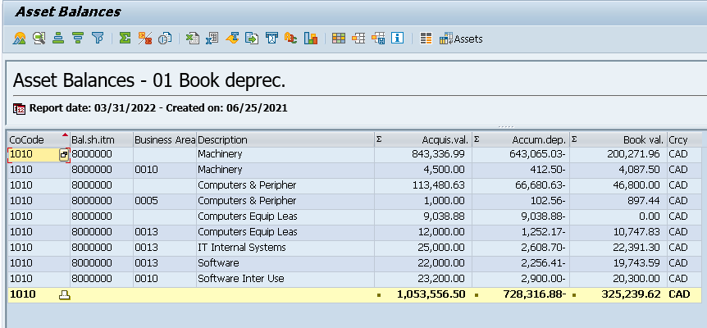
Asset Balance Report - SAP t-code: S_ALR_87011963
Enables you to understand the netbook value of fixed assets derived from acquisition and production costs (APC) and depreciation
Report displays information including:
  Acquisition valuation
  Accumulated depreciation
  Book value

Slide 83
Demo 5.13: Generate an Asset Balance Report
A laptop is being retired with revenue that must be recorded. Generate the report and review the Accumulated Depreciation and Net Book Value of the asset
Notes
  Transaction Code: S_ALR_87011963
Notes:
Demonstration using:
Field: value
Field: value
Action
Other steps

Slide 84
Exercise 5.13: Generate an Asset Balance Report
A laptop is being retired with revenue that must be recorded. Generate the report and review the Accumulated Depreciation and Net Book Value of the asset
Generate an asset balance report
Notes
  Transaction Code: S_ALR_87011963
Notes:
Data Fields:
Field: value
Field: value

Slide 85
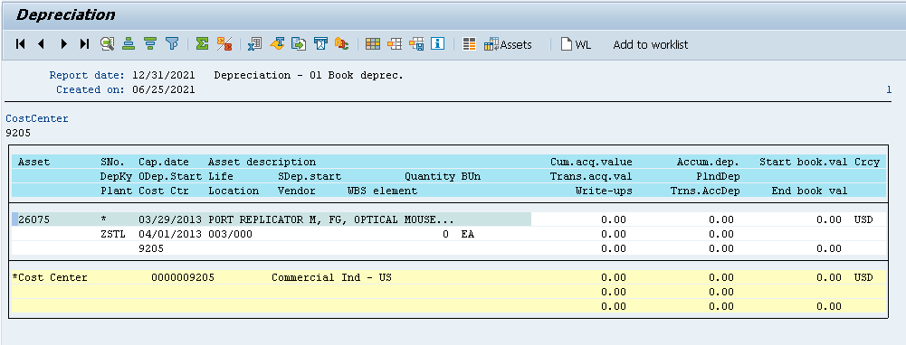
Depreciation Report – SAP t-code: S_ALR_87012004
Report enables you to view the reduction in value of an asset
Items available for review include:
  Cumulative acquisition value
  Accumulated depreciation
  End book value

Slide 86
Demo 5.14: Generate a Depreciation Report
You need to review the depreciation of laptops the organization has on the books. Generate the depreciation report and review the Cumulative Acquisition value, Accumulated Depreciation, and End Book Value of the assets
Notes
  Transaction Code: S_ALR_87012004
Notes:
Demonstration using:
Field: value
Field: value
Action
Other steps

Slide 87
Exercise 5.14: Generate a Depreciation Report
You need to review the depreciation of laptops the organization has on the books. Generate the depreciation report and review the Cumulative Acquisition value, Accumulated Depreciation, and End Book Value of the assets
Generate a depreciation report
Notes
  Transaction Code: S_ALR_87012004
Notes:
Data Fields:
Field: value
Field: value

Slide 88
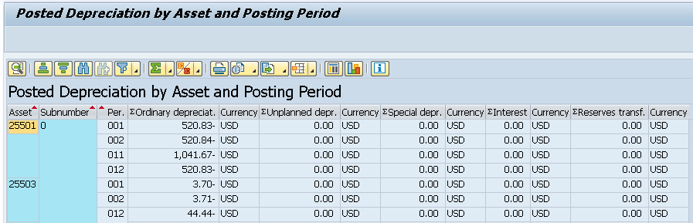
Posted Depreciation by Asset and Posting Period
SAP t-code S_P99_41000192 allows you to review depreciation for each asset
Items available for review include:
  Ordinary depreciation
  Unplanned depreciation

Slide 89
Demo 5.15: Generate a Posted Depreciation Report
You need to review assets currently held by the organization. Generate the posted depreciation report and review the Ordinary Depreciation and Unplanned Depreciation of the assets
Notes
  Transaction Code: S_P99_41000192
Notes:
Demonstration using:
Field: value
Field: value
Action
Other steps

Slide 90
Exercise 5.15: Generate a Posted Depreciation Report
You need to review assets currently held by the organization. Generate the posted depreciation report and review the Ordinary Depreciation and Unplanned Depreciation of the assets
Generate a posted depreciation report
Notes
  Transaction Code: S_P99_41000192
Notes:
Data Fields:
Field: value
Field: value

Slide 91
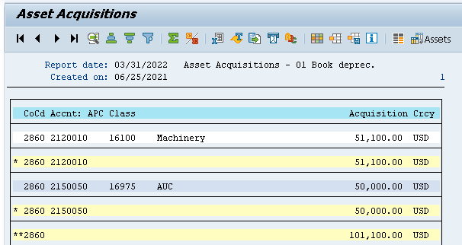
Asset Acquisitions – SAP t-code: S_ALR_87012050
Allows you to view all acquisitions in a given period
Items available for review include:
  APC Class
  Acquisition Currency

Slide 92
Demo 5.16: Generate an Asset Acquisitions Report
You need to review the asset acquisitions acquired between the months of March and July 2021. Generate an asset acquisitions report and review the APC Class and Acquisition Currency
Notes
  Transaction Code: S_ALR_87012050
Notes:
Demonstration using:
Field: value
Field: value
Action
Other steps

Slide 93
Exercise 5.16: Generate an Asset Acquisitions Report
You need to review the asset acquisitions acquired between the months of March and July 2021. Generate an asset acquisitions report and review the APC Class and Acquisition Currency
Generate an asset acquisitions report
Notes
  Transaction Code: S_ALR_87012050
Notes:
Data Fields:
Field: value
Field: value

Slide 94
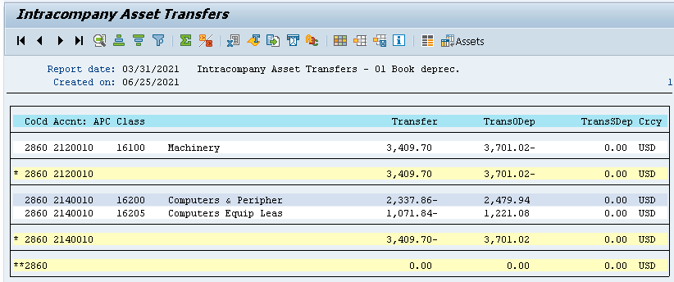
Asset Transfers – SAP t-code: S_ALR_87012054
Allows you to view all assets transferred within the organization
Items available for review include:
  APC Class
  Transfer amount

Slide 95
Demo 5.17: Generate an Asset Transfer Report
You need to review a list of assets that have been transferred as of March 31st 2021. Generate an asset transfer report and review the APC Class and Transfer amount
Notes
  Transaction Code: S_ALR_87012054
Notes:
Demonstration using:
Field: value
Field: value
Action
Other steps

Slide 96
Exercise 5.17: Generate an Asset Transfer Report
You need to review a list of assets that have been transferred as of March 31st 2021. Generate an asset transfer report and review the APC Class and Transfer amount
Generate an asset transfer report
Notes
  Transaction Code: S_ALR_87012054
Notes:
Data Fields:
Field: value
Field: value

Slide 97
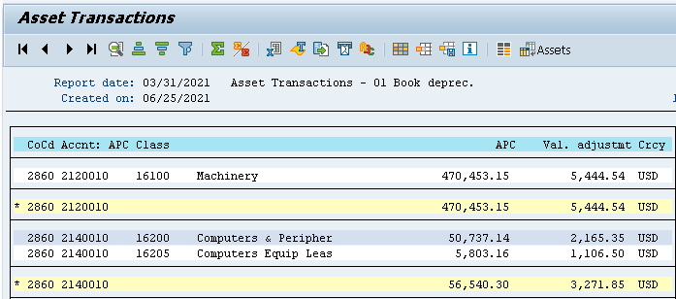
Asset Transaction – SAP t-code: S_ALR_87012048
Allows you to view all asset transactions within the organization
Items available for review include:
  APC Class
  APC

Slide 98
Demo 5.18: Generate an Asset Transaction Report
You need to review a list of asset transactions as of March 31st 2021. Generate an asset transfer report and review the APC Class and APC
Notes
  Transaction Code: S_ALR_87012048
Notes:
Demonstration using:
Field: value
Field: value
Action
Other steps

Slide 99
Exercise 5.18: Generate an Asset Transaction Report
You need to review a list of asset transactions as of March 31st 2021. Generate an asset transfer report and review the APC Class and APC
Generate an asset transaction report
Notes
  Transaction Code: S_ALR_87012048
Notes:
Data Fields:
Field: value
Field: value

Slide 100
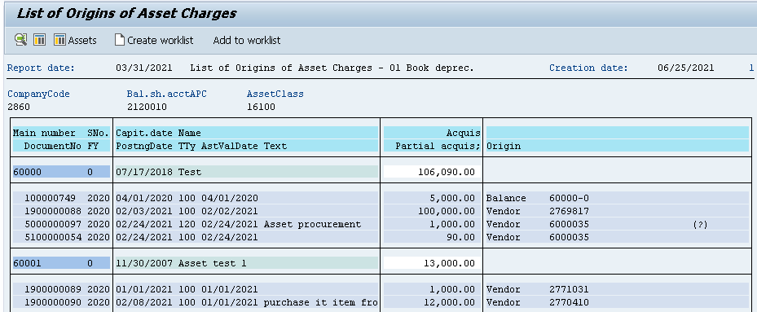
List of Origins by Asset Debits
SAP t-code S_ALR_87012058 Allows you to understand how the acquisition cost of an asset originated
Items available for review include:
  Acquisition/Partial Acquisition
  Origin

Slide 101
Demo 5.19: Generate List of Origins by Asset Debit
You need to review the acquisition cost of an asset as of March 31st 2021. Generate a list of origins by asset debit report and review the Acquisition/Partial Acquisition and Origin
Notes
  Transaction Code: S_ALR_87012058
Notes:
Demonstration using:
Field: value
Field: value
Action
Other steps

Slide 102
Exercise 5.19: Generate List of Origins by Asset Debit
You need to review the acquisition cost of an asset as of March 31st 2021. Generate a list of origins by asset debit report and review the Acquisition/Partial Acquisition and Origin
Generate list of origins by asset debit
Notes
  Transaction Code: S_ALR_87012058
Notes:
Data Fields:
Field: value
Field: value

Slide 103
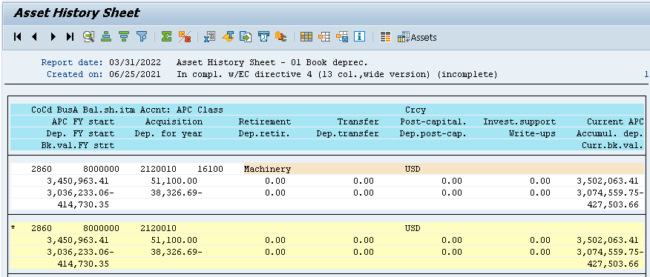
Asset History Sheet – SAP t-code: S_ALR_87011990
Provides year to date balance per asset class
Can be drilled down to view individual asset information
Items available for review include:
  APC FY start
  Current APC

Slide 104
Demo 5.20: Generate an Asset History Sheet
You need to review the current balance of assets as of March 31st 2021. Generate an asset history sheet and review the Acquisition Depreciation for Year and Current APC Accumulation Depreciation
Notes
  Transaction Code: S_ALR_87011990
Notes:
Demonstration using:
Field: value
Field: value
Action
Other steps

Slide 105
Exercise 5.20: Generate an Asset History Sheet
You need to review the current balance of assets as of March 31st 2021. Generate an asset history sheet and review the Acquisition Depreciation for Year and Current APC Accumulation Depreciation
Generate an asset history sheet
Notes
  Transaction Code: S_ALR_87011990
Notes:
Data Fields:
Field: value
Field: value

Slide 106
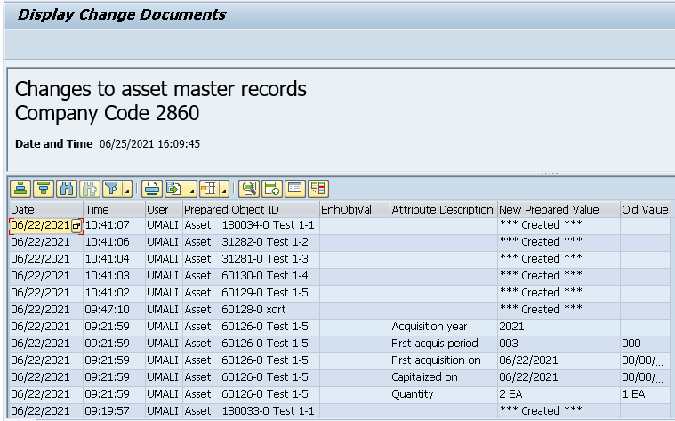
Asset Master Changes
SAP t-code S_ALR_87012037 displays master data change information
Items available for review include:
  Attribute Description
  New Prepared Value
  Old Value

Slide 107
Demo 5.21: Generate an Asset Master Change Report
Review the history of changes made to an asset. Generate an asset master change report and review the Attribute Description, New Prepared Value, and the Old Value
Notes
  Transaction Code: S_ALR_87012037
Notes:
Demonstration using:
Field: value
Field: value
Action
Other steps

Slide 108
Exercise 5.21: Generate an Asset Master Change Report
Review the history of changes made to an asset. Generate an asset master change report and review the Attribute Description, New Prepared Value, and the Old Value
Generate an asset master change report
Notes
  Transaction Code: S_ALR_87012037
Notes:
Data Fields:
Field: value
Field: value

Slide 109
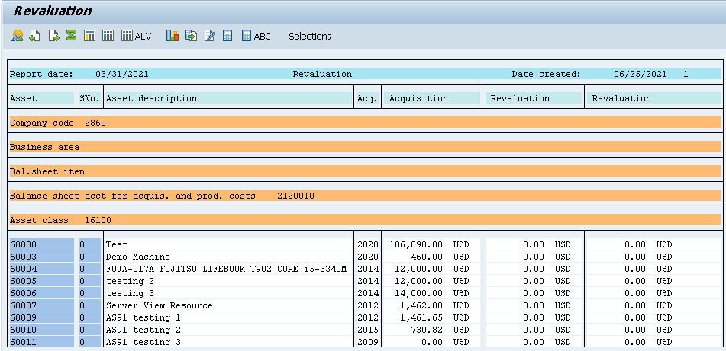
Revaluation Report – T-code: S_ALR_87010173
Displays asset revaluation balances as required
Items available for review include:
  Acquisition
  Revaluation

Slide 110
Demo 5.22: Generate a Revaluation Report
Review the revaluation balances made to an asset. Generate a revaluation report and review the Acquisition and Revaluation balances
Notes
  Transaction Code: S_ALR_87010173
Notes:
Demonstration using:
Field: value
Field: value
Action
Other steps

Slide 111
Exercise 5.22: Generate a Revaluation Report
Review the revaluation balances made to an asset. Generate a revaluation report and review the Acquisition and Revaluation balances
Generate a revaluation report
Notes
  Transaction Code: S_ALR_87010173
Notes:
Data Fields:
Field: value
Field: value

Slide 112
Unit 5, # 1
What does generating asset balance report allow you to understand regarding an asset?

Slide 113
Unit 5, # 1
What does generating an asset balance report allow you to understand regarding an asset?
  It enables you to understand the netbook value of fixed assets derived from acquisition and production costs (APC) and depreciation

Slide 114
5
You should now be able to:
Generate fixed assets reports

Slide 116
Agenda
Unit 1 – Introduction – Fixed Assets (20 mins)
Unit 2 – Creating/Editing Assets (60 mins)
Unit 3 – Processing Asset Transfers (60 mins)
Unit 4 – Depreciating an Asset (110 mins)
Unit 5 – Generating an Asset Report (30 mins)
Unit 6 – Summary (10 mins)

Slide 117
Course Key Points
  A Fixed Asset is a long-term tangible piece of property that FAI owns and/or leases and is not expected to be consumed or converted into cash in the near future
  Asset Management Lifecycle consists of:
    Procuring Assets
    Registering Assets
    Adjusting Assets
    Transferring Assets
    Depreciating Assets
    Disposing Assets

Slide 118
Course Key Points (Cont.)
  Master data does not change frequently
  Revaluation of fixed assets is the process of increasing or decreasing their carrying value in case of major changes in fair market value of the fixed asset
  Transfers from one fixed asset to another within the same company code can be carried out in one step using transaction code: ABT1N
  A master record must exist prior to processing the transfer
  An intercompany transfer represents a retirement for one company and an acquisition for the other

Slide 119
Course Key Points (Cont.)
  Possible roadblock to manual depreciation is if postings exist against the asset. Manual depreciation cannot be completed with existing postings
  The depreciation run is a periodic processing program in asset accounting that posts planned depreciation to all relevant assets
  Determination for complete/partial retirement based on
    Retirement dates entered
    The amounts to be charged off for each depreciation area

Slide 120
Course Summary
You should now be able to:
Describe the fixed assets process
Create Asset Master Data
Process different types of transfers
Perform the various methods for depreciating assets
Generate fixed assets reports

Slide 121

Next Steps
Practice: Prior to go live, be sure to practice the transactions exercised today using the following resources available:
  Training Environment and Training ID (TBD)
  uPerform recordings located in the LMS (TBD)
If you have questions...
  Help Desk (TBD)
  LMS/SharePoint site for reference materials (TBD)
  Other Users
  Super Users

Slide 122

Before You Leave…
Last chance for Q & A!
Please be sure to complete the Class evaluation in order to help us improve on future classes!
57

Slide 123

Congratulations!
You have completed this course!

